Slide 1

Machine Learning
Session 2

Slide 2




Session 2
Content
Linear regression with one variable review.
cost function review.
gradient descent.
------Break------
pandas & numpy.
Appling with code.
Grow Through

Slide 3
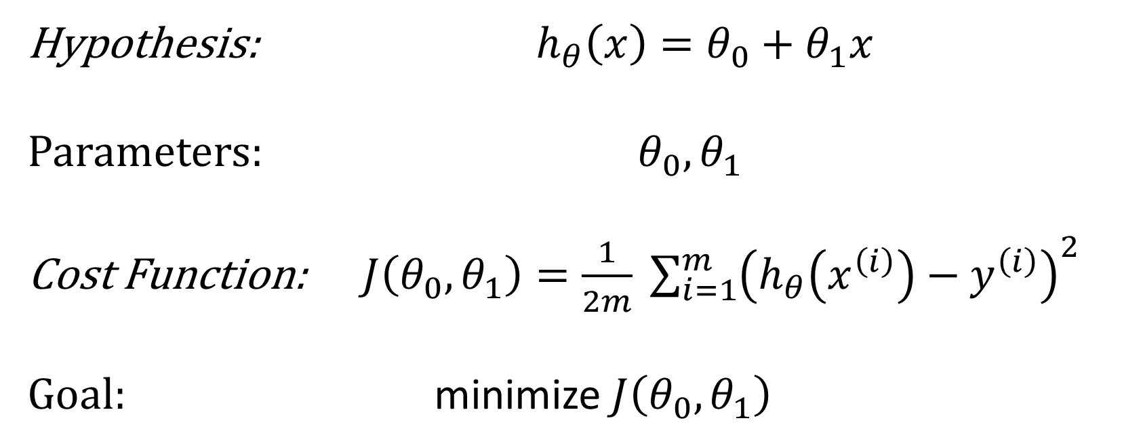
Linear Regression problem with one variable
Hypothesis: $h_{θ}\left(x\right)=θ_{0}+θ_{1}x$
Parameters: $θ_{0},θ_{1}$
Cost Function: $J\left(θ_{0},θ_{1}\right)=\frac{1}{2m} \sum_{i=1}^{m}{{\left(h_{θ}\left(x^{\left(i\right)}\right)−y^{\left(i\right)}\right)}^{2}}$
Goal: minimize $J\left(θ_{0},θ_{1}\right)$
Grow Through

Slide 4
Session 2
Gradient descent
Text
Grow Through

Slide 5
Goodbye
Grow Through

